Slide 1

Geometry
Unit 10, Lesson 2 Arc Length Volume 2, pg. 124

Slide 2


Benchmark
MA.912.GR.6.4
Solve mathematical and real-world problems involving the arc length and area of a sector in a given circle.
volume 2, pg. 124

Slide 3
Integrated Mathematical Thinking and Reasoning Standards
MA.K12.MTR.1.1 Actively participate in effortful learning both individually and collectively.
MA.K12.MTR.2.1 Demonstrate understanding by representing problems in multiple ways.
MA.K12.MTR.4.1 Engage in discussions that reflect on the mathematical thinking of self and others.
MA.K12.MTR.5.1 Use patterns and structure to help understand and connect mathematical concepts.
MA.K12.MTR.6.1 Assess the reasonableness of solutions.
volume 2, pg. 124

Slide 4

Learning Targets
I can define arc length.
I can explain how the length of an arc is proportional to the ratio of the central angle to the whole circle, measured in degrees.
volume 2, pg. 124

Slide 5

Warm-Up
volume 2, pg. 125

Slide 6
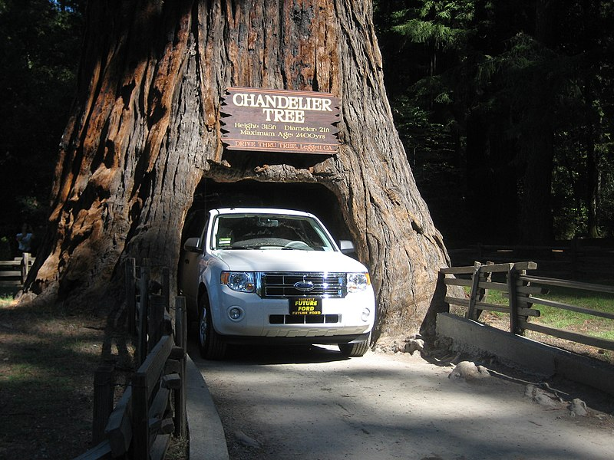
10.2.1 Warm-Up: Notice and Wonder
The Chandelier Tree, located in Leggett California, is part of a drive-thru tree park. The tree is believed to have been carved in the early 1930’s by Charlie Underwood.
volume 2, pg. 125

Slide 7
What do you notice?
What do you wonder?
Estimate the diameter of the tree at the base.
Explain why you chose that number as your estimate.
volume 2, pg. 125

Slide 8

Exploration
volume 2, pg. 125

Slide 9

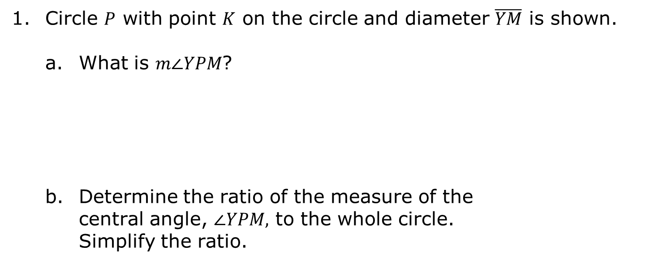
10.2.2 Exploration: Arc Length and Proportional Relationships
Circle $P$ with point $K$ on the circle and diameter $\overline{YM}$ is shown.
What is $m∠YPM$?
Determine the ratio of the measure of the central angle, $∠YPM,$ to the whole circle. Simplify the ratio.
volume 2, pg. 125

Slide 10
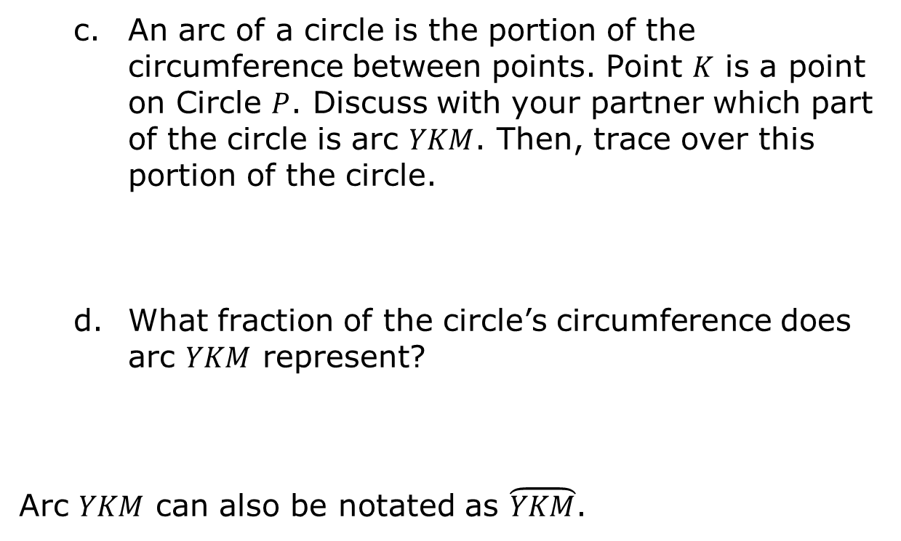
An arc of a circle is the portion of the circumference between points. Point $K$ is a point on Circle $P$. Discuss with your partner which part of the circle is arc $YKM$. Then, trace over this portion of the circle.
What fraction of the circle’s circumference does arc $YKM$ represent?
Arc $YKM$ can also be notated as $\overset{⏜}{YKM}$.
volume 2, pg. 125

Slide 11
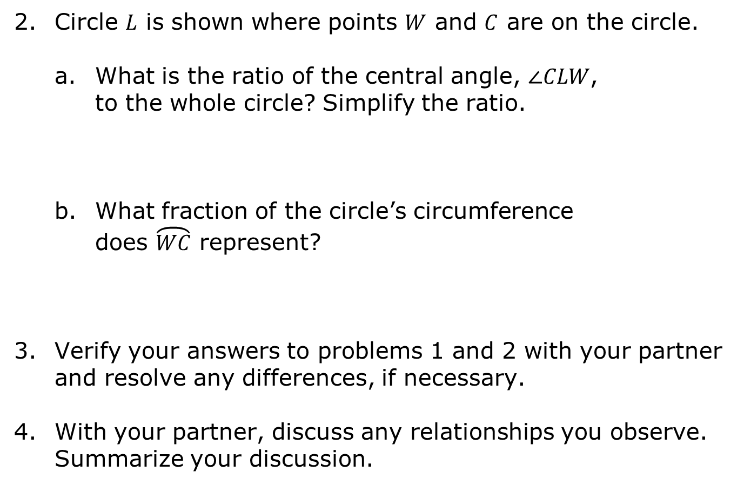
Circle $L$ is shown where points $W$ and $C$ are on the circle.
What is the ratio of the central angle, $∠CLW$, to the whole circle? Simplify the ratio.
What fraction of the circle’s circumference does $\overset{⏜}{WC}$ represent?
Verify your answers to problems 1 and 2 with your partner and resolve any differences, if necessary.
With your partner, discuss any relationships you observe. Summarize your discussion.
volume 2, pg. 126

Slide 12
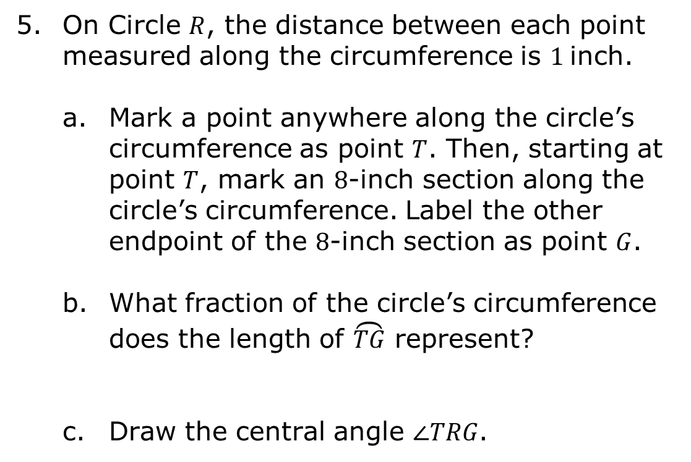
On Circle $R$, the distance between each point measured along the circumference is $1$inch.
Mark a point anywhere along the circle’s circumference as point $T$. Then, starting at point $T$, mark an $8$-inch section along the circle’s circumference. Label the other endpoint of the $8$-inch section as point $G$.
What fraction of the circle’s circumference does the length of $\overset{⏜}{TG}$ represent?
Draw the central angle $∠TRG$.
volume 2, pg. 126

Slide 13
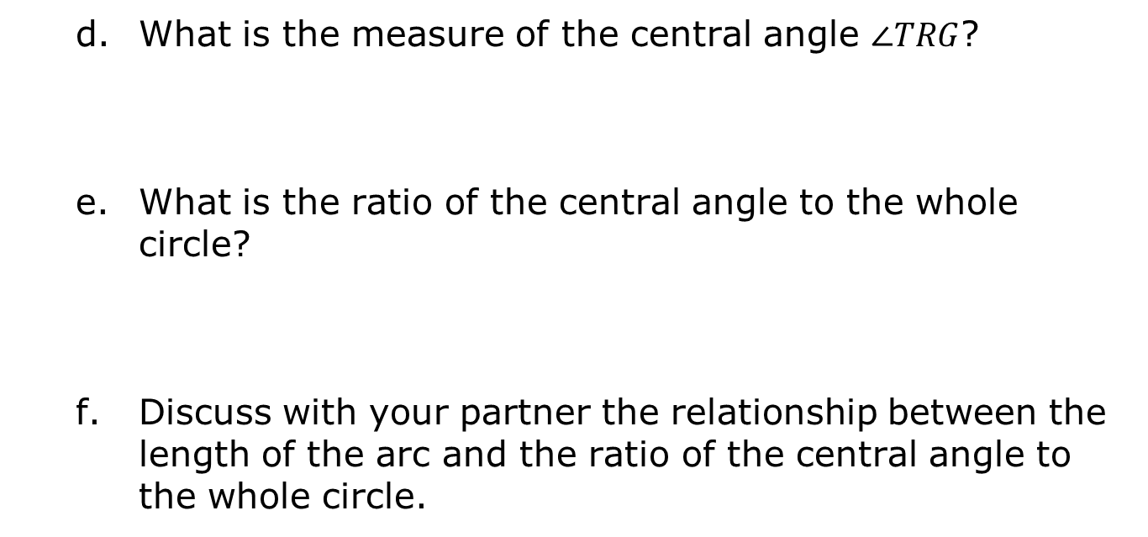
What is the measure of the central angle $∠TRG$?
What is the ratio of the central angle to the whole circle?
Discuss with your partner the relationship between the length of the arc and the ratio of the central angle to the whole circle.
volume 2, pg. 126

Slide 14
Complete the statements.
The is the distance along the part of
a circle’s circumference or along any curve.
The ratio of the length of an arc to the circumference of a
circle is the ratio of the central angle
to the whole circle.
arc length
diameter
radius
the inverse of
proportional to
volume 2, pg. 127

Slide 15

Activity
volume 2, pg. 127

Slide 16

10.2.3 Activity: Matching Central Angles and Ratios of Arc Length to Circumference
Your teacher will give you two sets of cards for this activity. One set shows circles with a central angle. The other set of cards is a set of ratios of the arc length to the circumference.
Work with your partner to match each circle card to the corresponding ratio indicated on the lettered card. Record the matches in the table.
volume 2, pg. 127

Slide 17
Card Letter | Ratio of the Arc Length to the Circumference | Card Letter | Ratio of the Arc Length to the Circumference
A |  | F
B |  | G
C |  | H
D |  | I
E |  | J
Summarize how you and your partner were able to match the circles to a corresponding ratio without being given the circumference.
volume 2, pg. 127

Slide 18
Complete the statement.
The ratio of the central angle to the whole circle is the
the ratio of the length of an arc to
the circumference.
inverse of
same as
volume 2, pg. 128

Slide 19
Exploration
volume 2, pg. 128

Slide 20
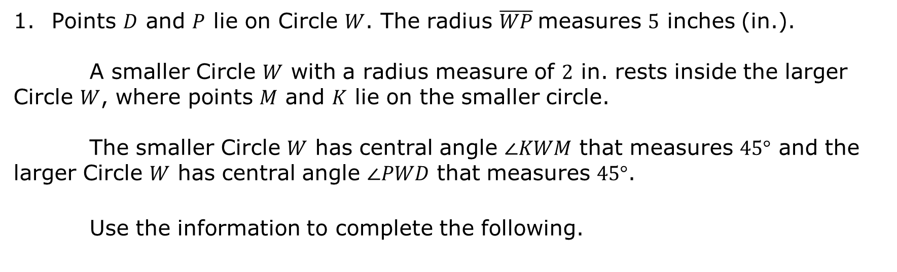
10.2.4 Exploration: Arc Lengths With the Same Central Angle and Different Radii
Points $D$ and $P$ lie on Circle $W$. The radius $\overline{WP}$measures $5$ inches (in.).
A smaller Circle $W$ with a radius measure of $2$ in. rests inside the larger Circle $W$, where points $M$ and $K$ lie on the smaller circle.
The smaller Circle $W$ has central angle $∠KWM$ that measures $45°$ and the larger Circle $W$ has central angle $∠PWD$ that measures $45°$.
Use the information to complete the following.
volume 2, pg. 128

Slide 21
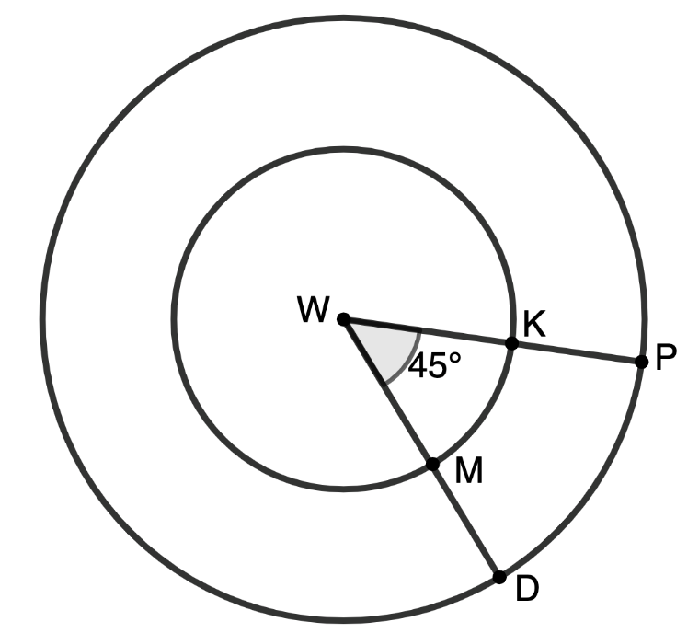
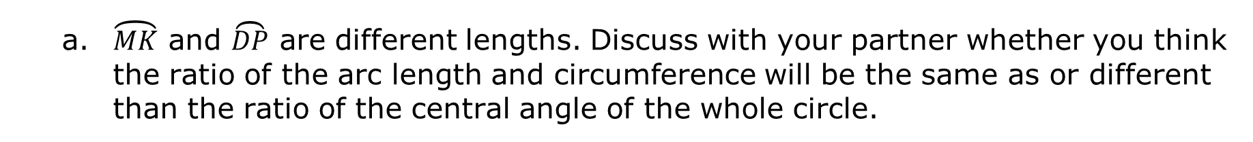
a. $\overset{⏜}{MK}$ and $\overset{⏜}{DP}$ are different lengths. Discuss with your partner whether you think the ratio of the arc length and circumference will be the same as or different than the ratio of the central angle of the whole circle.
volume 2, pg. 128

Slide 22
Andrew and Sarah are discussing if the ratio of the arc length to the circumference is the same as the ratio of the central angle to the whole circle for both the smaller and larger circles.
Explain who you agree with.
Sarah says, “Yes. They will have the same ratios because they have the same central angle.” | Andrew says, “No. They do not have the same ratios because they are different circles with different radii.”
volume 2, pg. 129

Slide 23
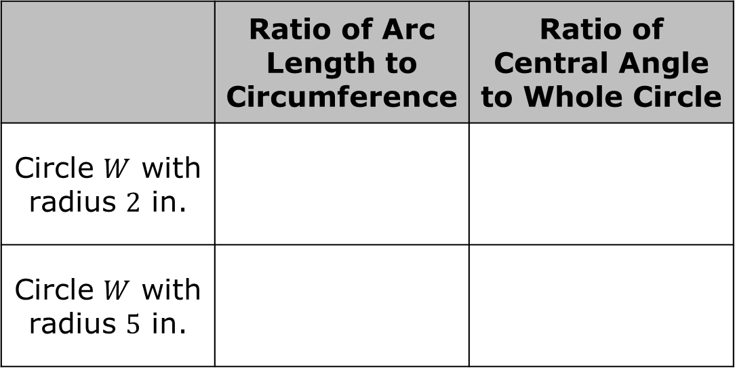
Complete the table to support your reasoning in Part B.
Explain whether your findings in Part C support your answers to Parts A and B. If not, explain why your answers to Parts A and B are incorrect.
 | Ratio of Arc Length to Circumference | Ratio of Central Angle to Whole Circle
Circle $W$ with radius $2$ in.
Circle $W$ with radius $5$ in.
volume 2, pg. 129

Slide 24

Wrap-Up
volume 2, pg. 129

Slide 25
10.2.5 Wrap-Up: Cool Down
Write a summary of what you learned in this lesson.
volume 2, pg. 129

